Slide 1
DATA QUALITY
ISSUES
Data quality and errors – Sources of error in GIS – Finding and modeling errors of GIS – Managing GIS error

Slide 2
INTRODUCTION
Quality is a word in a dictionary define that ‘degree of excellence’.
In GIS, data quality is used to give an indication of how good data are.

Slide 3
INTRODUCTION
In many industries, quality control is everything.
GIS users strive for quality products from their systems.

Slide 4
INTRODUCTION
Errors can enter a GIS in many different ways.
For example:
A mistake in digitizing a field boundary.
A mistake in the transcription of a grid reference.
Misinterpretation of satellite imagery.

Slide 5
INTRODUCTION
Two issues are:
First, the terminology, and
Second, the sources, propagation and management.
Words such as quality, accuracy and error not only mean different things to different people but also have precise technical definitions.

Slide 6
INTRODUCTION
data error and quality are introduced to solve problems.
sources of errors to recognize and deal with problems.

Slide 7
DESCRIBING DATA QUALITY AND
ERRORS
In GIS, data quality is used to give an indication of good data.

Slide 8
DESCRIBING DATA QUALITY AND
ERRORS
Issues such as error, accuracy, precision and bias can help to assess the quality.
In addition, the resolution and generalization.

Slide 9
DESCRIBING DATA QUALITY AND
ERRORS
A systematic error would have occurred.

Slide 10
DESCRIBING DATA QUALITY AND
ERRORS
Accuracy of reality.

Slide 11
DESCRIBING DATA QUALITY AND
ERRORS
Precision is the recorded.

Slide 12
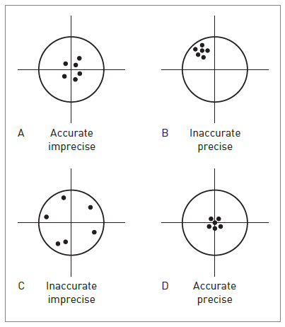
The difference between accuracy and precision is Shown:

Slide 13
DESCRIBING DATA QUALITY AND
ERRORS
Bias in GIS data is the systematic variation of data

Slide 14
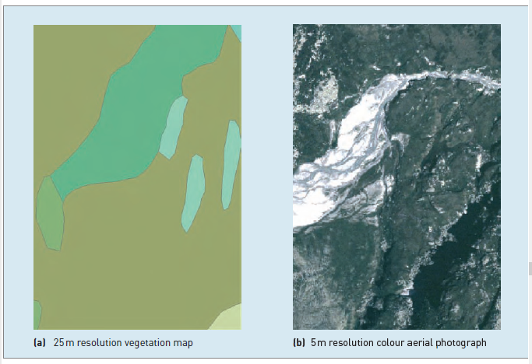
Resolution and generalization of raster datasets

Slide 15
DESCRIBING DATA QUALITY AND
ERRORS
Generalization is the process of simplifying the complexities.

Slide 16
DESCRIBING DATA QUALITY AND
ERRORS
Completeness, compatibility, consistency and applicability are introduced here.
A complete will cover period of interest.

Slide 17
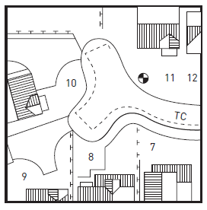
Scale-related generalization
1:10,000

Slide 18
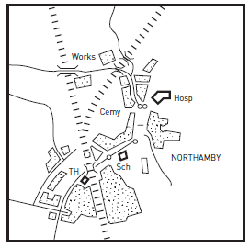
Scale-related generalization
1:50,000

Slide 19
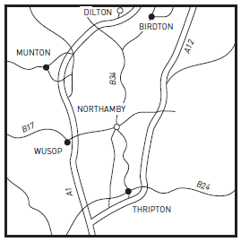
Scale-related generalization
1:500,000

Slide 20
DESCRIBING DATA QUALITY AND
ERRORS
Maps containing data measured in different scales of measurement cannot be combined easily.

Slide 21
DESCRIBING DATA QUALITY AND
ERRORS
Consistency applies not only to separate data sets but also within individual data sets.

Slide 22
SOURCES OF ERROR IN GIS
Spatial and attribute errors can occur at any stage

Slide 23
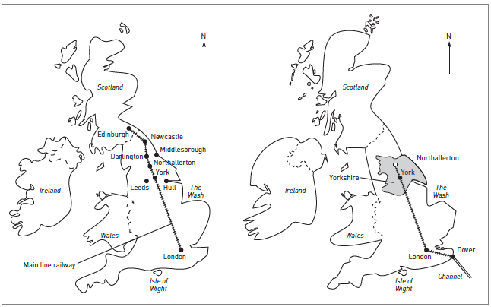
MENTAL MAPS

Slide 24
Errors arising from our understanding and modelling of reality
Our perception of reality influences our definition of reality.

Slide 25
Errors arising from our understanding and modelling of reality
Consider the problem of defining a common geographical feature such as a mountain in a GIS.

Slide 26
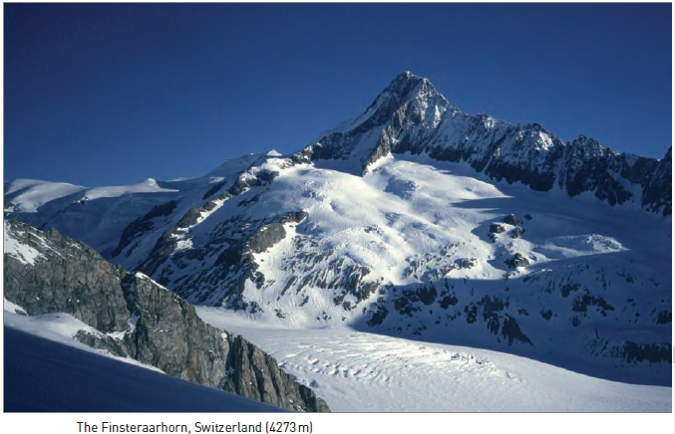
Finsteraarhorn, Switzerland (4273m)

Slide 27
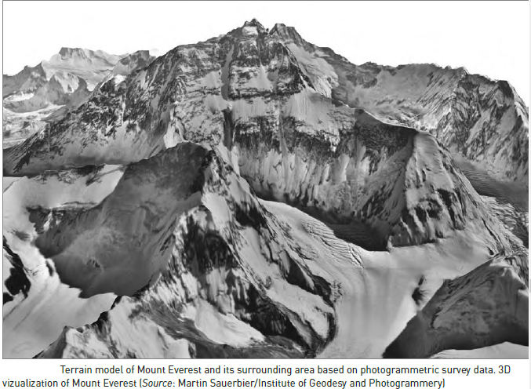
Terrain model of Mount Everest (8849 m)

Slide 28
Errors arising from our understanding and modelling of reality
The problem of identifying mountains.

Slide 29
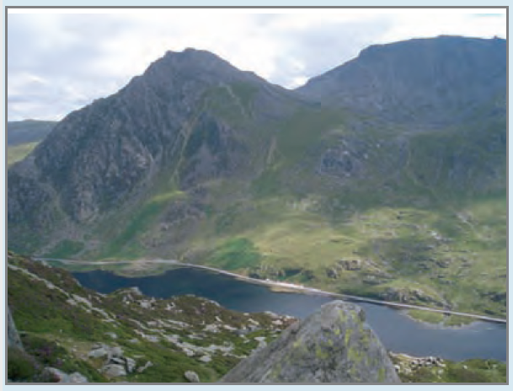
Visualize the problem for Tryfan; a mountain in north Wales.
Photograph of Tryfan

Slide 30
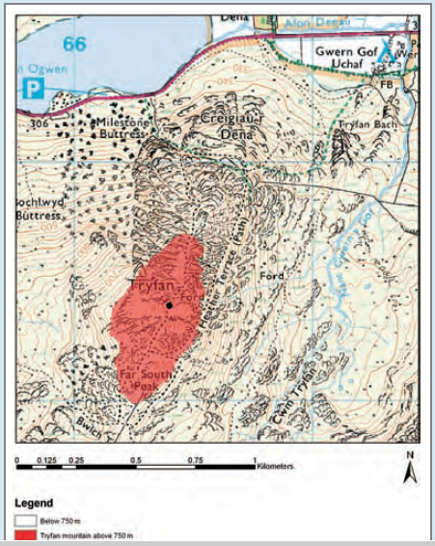
Ordnance Survey 1:50,000 topographic map showing area above 750m

Slide 31
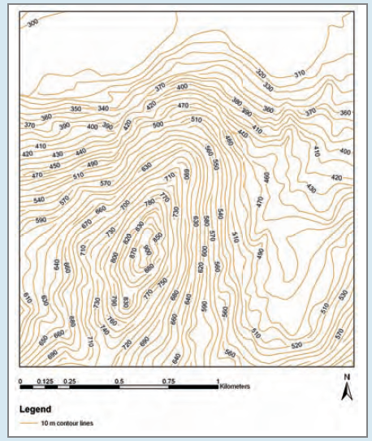
Contour map

Slide 32
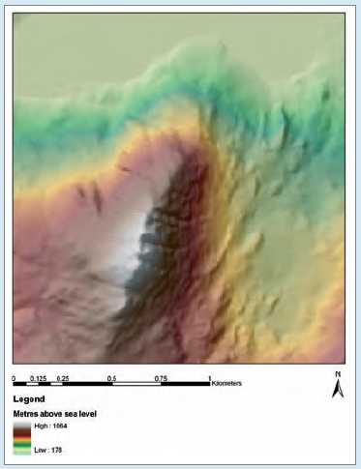
DEM Representation

Slide 33
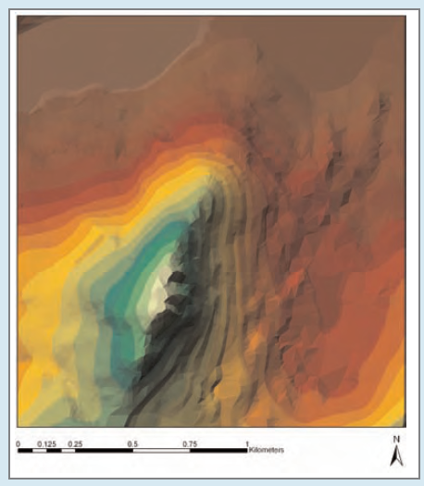
TIN Representation

Slide 34
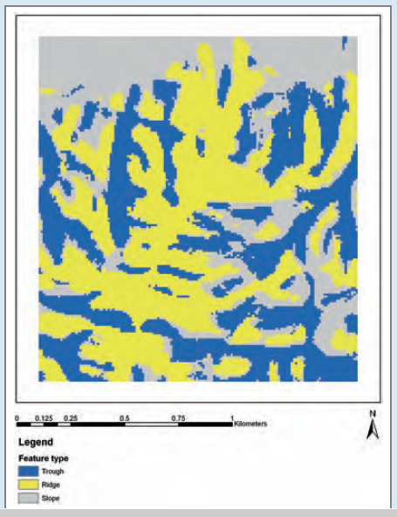
Topographic features

Slide 35
Errors in source data for GIS
All sources of spatial and attribute data are likely to include errors.

Slide 36
Errors in source data for GIS
Cartographic data sources error are:
  CONTINUOUS DATA
  FUZZY BOUNDARIES
  MAP SCALE
  MAP MEASUREMENTS

Slide 37
Errors in data encoding
Data encoding is the process by which data are transferred from some non-GIS source.

Slide 38
Errors in data encoding
Two main types:
source map error and
operational error.
Categorizes human digitizing error into two types:
  psychological and
  physiological.

Slide 39
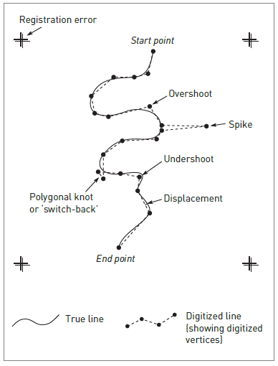
Operational errors

Slide 40
Operational errors
3 Line thickness.
4 Method of digitizing. Two methods :
  point mode and
  stream mode.

Slide 41
Errors in data editing and conversion
After data encoding is complete, cleaning and editing.

Slide 42
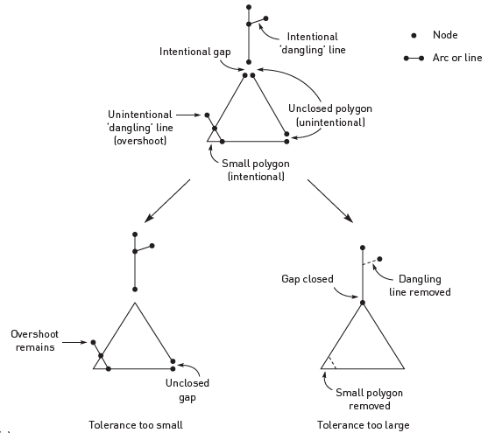
Topological errors in vector GIS
Effects of tolerances on topological cleaning

Slide 43
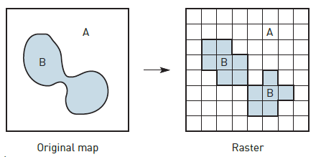
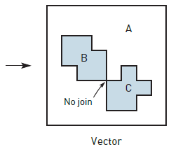
Topological ambiguities in raster to vector conversion

Slide 44
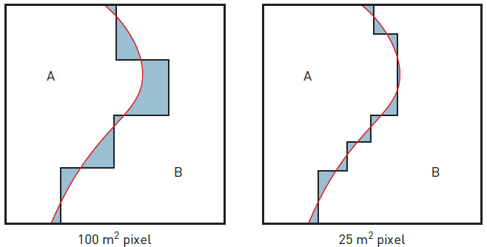
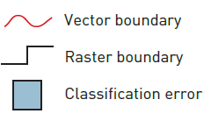
Vector to raster classification error

Slide 45
Rasterization errors
Vector to raster conversion.
For example:
1 Topological errors.
2 Loss of small polygons.
3 Effects of grid orientation.
4 Variations in grid origin and datum.

Slide 46
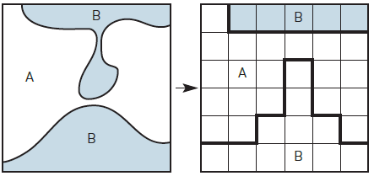
Loss of connectivity and creation of false connectivity

Slide 47
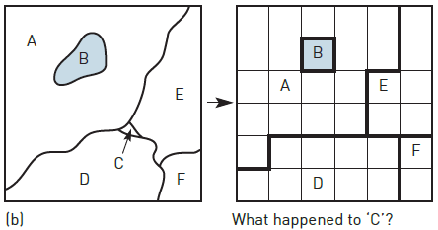
Loss of Information

Slide 48
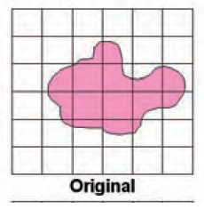
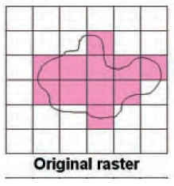
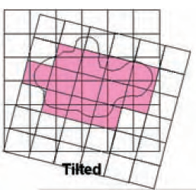
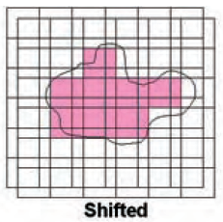
Effect of grid orientation
Effect of grid orientation and origin on rasterization

Slide 49
Errors in data processing and analysis
Errors may be introduced during the manipulation and analysis of the GIS database.
For example: Are the data suitable for this analysis? Are they in a suitable format? Are the data sets compatible?
Are the data relevant? Will the output mean anything? Is the proposed technique appropriate to the desired output?

Slide 50
Errors in data processing and analysis
Classification errors also affect raster data.
Classified satellite images provide a reflectance value
Raster maps of environmental variables, present the reflectance values.

Slide 51
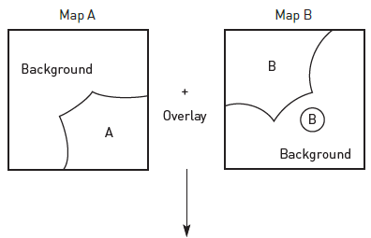
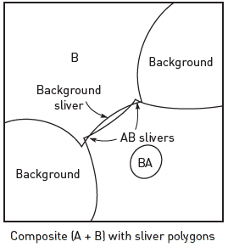
Generation of sliver polygons

